Slide 1
TECH-TO-DREAMS
Generally in today’s farming , farmers are facing lots of problems due to cattle because the stray animals due to search of food enter in the crop field and destroy the crop at other hand the insects and pest.
KRISHANKANT YADAV ML/AI
NARESH SUMAN ARDIUNO EXPERT
RASHI VERMA PYTHON
NIKITA KUMARI C/C++
KHUSHI VERMA VIDEO GRAPHICS
DISHA CHOUDHARY DATA MANAGEMENT
Date : 22-05-2002

Slide 2
Why?
Generally in today’s farming , farmers are facing lots of problems due to cattle because the stray animals due to search of food enter in the crop field and destroy the crop at other hand the insects and pest.
EXAMPLE 1 :
mainly the desert locust they eat the leaves and flowers and slowly reach to the roots and the crop completely destroy.
EXAMPLE 2 :
Cattle’s problems in state UP , MP , MAHARASTRA , PUNJAB , HARIYAANA etc.
States .

Slide 3
User Segment:
Analog Security Systems
IP Security Systems
Radio frequency technology
Radar Technology
Optical/ Visual technology
GPS
Machine Learning
Leaser beam

Slide 4
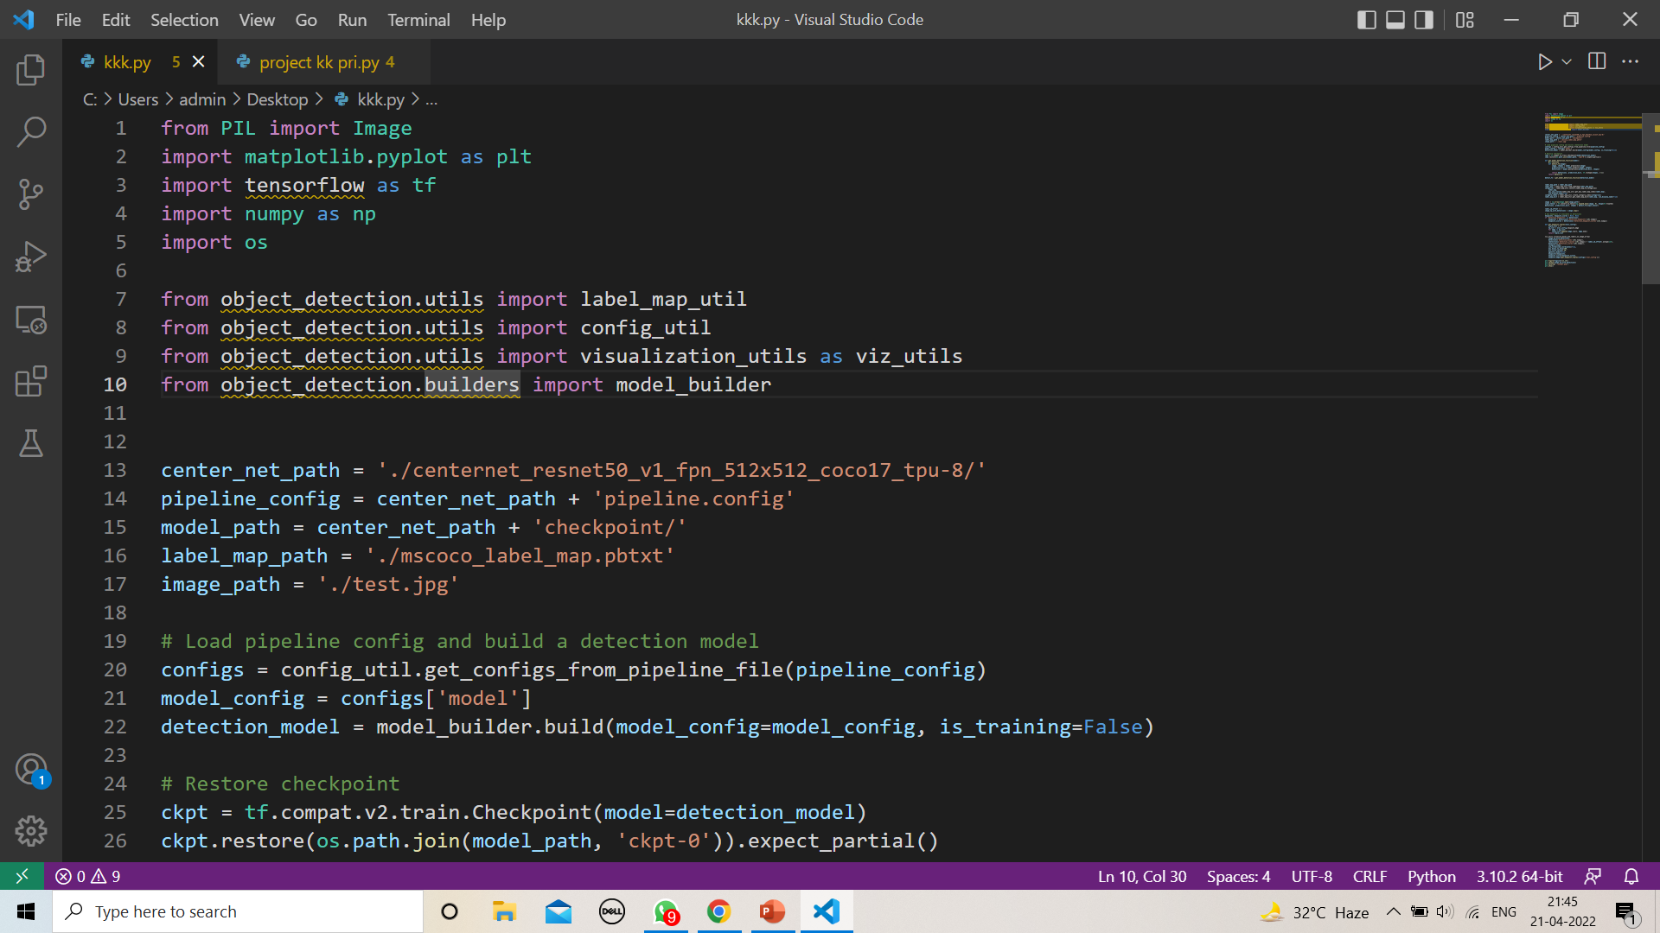
Current Landscape
All most compeleted the project.

Slide 5
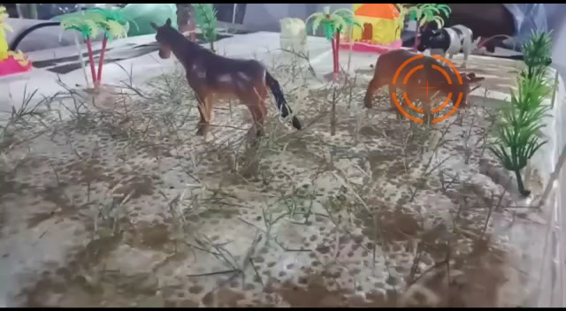
DEMO

Slide 6
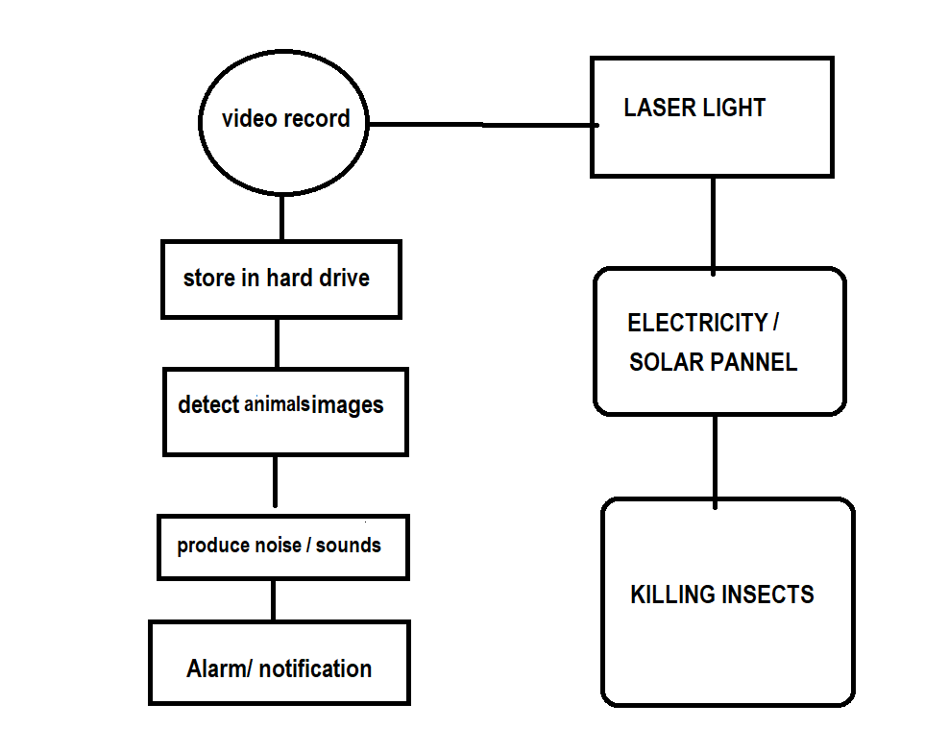
Key Differentiators & Adoption Plan
FLOW CHART

Slide 7
Future Vision
Present your solution, talk about methodology, architecture & scalability
We are converting a normal CCTV camera to a advanced camera for detecting animals and insects .
By using Ultrasonic + thermal detection+ Infrared rays laser beams .
video from the camera, compresses it, and then stores it on a hard drive for either live viewing and detect images of drone by using ML .
When it will detect any animals, it will gives us alarm and notification to owner and produce sound which help to distract the animals

Slide 8
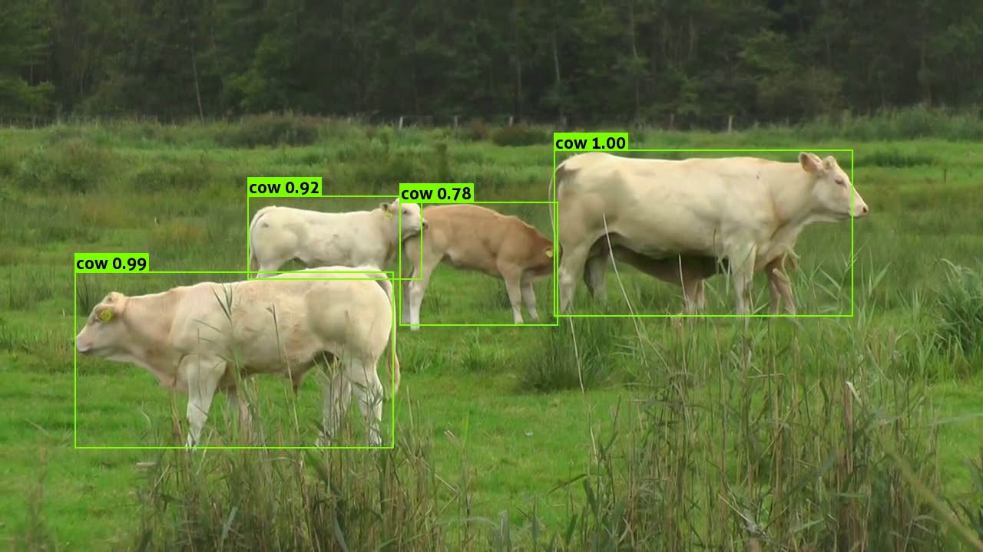
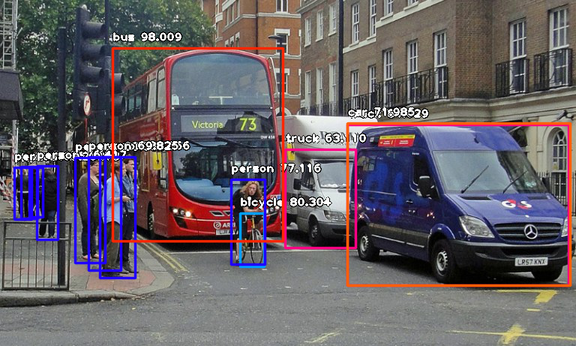
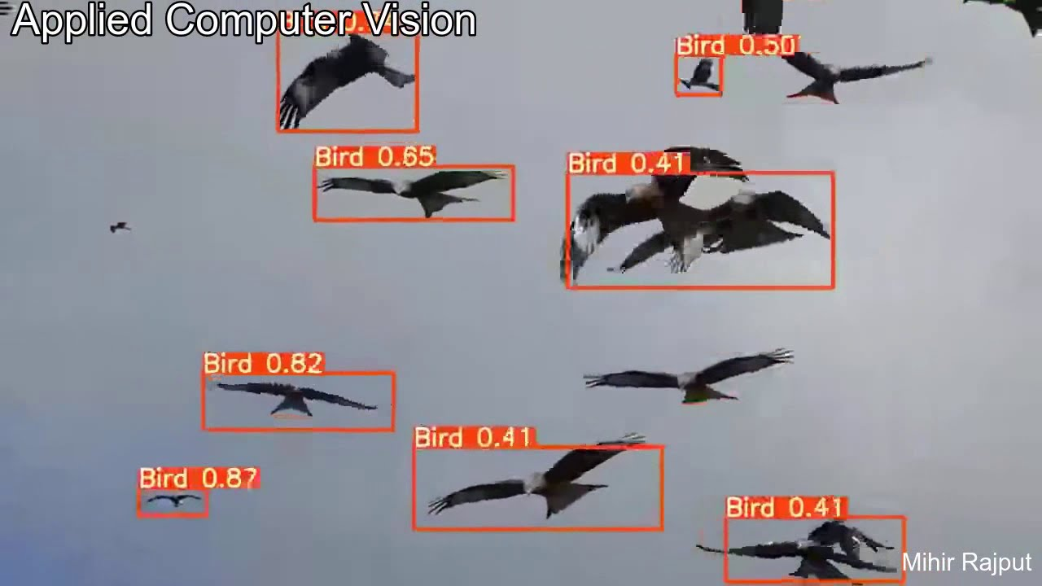
Moment!

Slide 9
Thank You
KRISHANKANT YADAV
NARESH SUMAN
RASHI VERMA
NIKITA KUMARI
KHUSHI VERMA
DISHA CHOUDHARY

